Slide 1
DevOps
Introduction to CI/CD

Slide 2
CONTENTS
Introduction
Review: What is DevOps?
Continuous Integration
Continuous Deployment
DevOps Tools
For Internal Use Only

Slide 3
Introduction

Slide 4
Introduction
Name
School Graduated
Age
Course
Fun Fact
Why Accenture?

Slide 5
REVIEW: What is DevOps?

Slide 6
REVIEW: What is DevOps?
Development
Operations
I want change
I want stability
DevOps
Classic
characterisation
Stable and operable software
Consistent and optimised release process
Conformance to infra and platform standards
Everyone wants
Low risk, high throughput of change
Confident code and software integrity
Highly available and predictable environments

Slide 7
REVIEW: What is DevOps?
Bringing Dev and Ops together requires excellent:
Configuration Management
Application Lifecycle Management
Environment Management
Tooling
Software and Infrastructure Automation

Slide 8
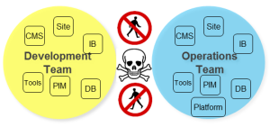
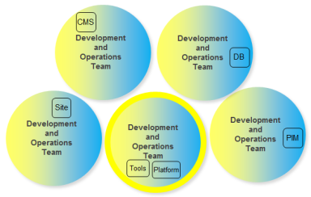
REVIEW: What is DevOps?
DCSC-preferred
Traditional
DevOps is “…the org structure that lets you release as fast as possible without losing control” ~Markos Rendell

Slide 9
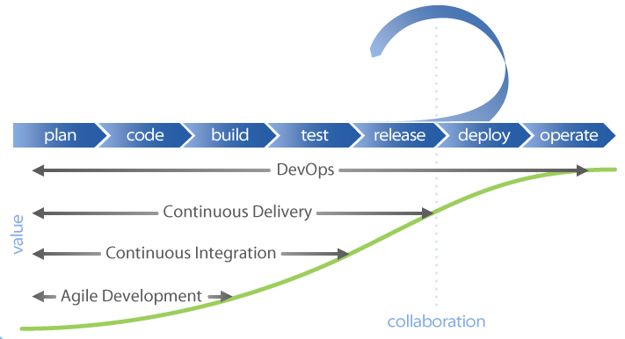
REVIEW: What is DevOps?

Slide 10
REVIEW: What is DevOps?
Development Architecture
User
Acceptance
Test
Scope
Scope
Agreement
Define Blueprint & Strategy
Implement, manage, maintain and improve processes
Configuration Management
Business
Process
Test
Strategy selection
Management, implementation and maintenance
HLD
Design
Review
Test Review
Transition to Production support
Select, Design & Build
Func.
Design
Assembly
Test
Environment Management
Design & build
Environment management, maintenance, support
Design
Review
Test Review
Delivery Management
Release Management`
Tech
Design
Link Test
CUT
Design
Review
Code Review
Code
Unit Test

Slide 11
Continuous Integration

Slide 12

Continuous Integration - Defined
^{[1]}Continuous Integration (CI) is a development practice that requires developers to integrate code into a shared repository several times a day. Each check-in is then verified by an automated build, allowing teams to detect problems early.
Notes:
[1] https://www.thoughtworks.com/continuous-integration

Slide 13
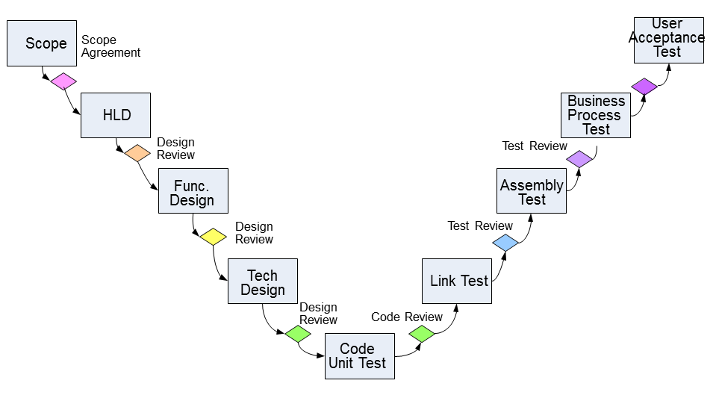
Continuous Integration
Compile & Package
Committer: jdoe
Story:25
Sonar Code Analysis
Commit ID: 113
Run Unit Tests
Notes:
Where does CI apply in the lifecycle?
Continuous integration is an industrialisation of the box at the bottom
Walk through the steps
Say this is more or less a view from the Jenkins tool which we’ll see later

Slide 14
Continuous Deployment

Slide 15
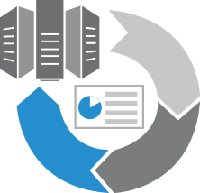
Continuous Deployment - Defined
Continuous Deployment is the release into production of software that passes the automated tests.
Essentially, “it is the practice of releasing every good build to users,” explains Jez Humble, author of Continuous Delivery.
Notes:
[1] https://www.thoughtworks.com/continuous-integration

Slide 16
Continuous Deployment
+
Compile & Package
Committer: jdoe
Story:25
Sonar Code Analysis
Create ST env
Deploy Code
Load Test Data
Run Test Harness
Create clustered env
Deploy Code
Run Perf Test
Commit ID: 113
Run Unit Tests
Tear down ST env
Run Security Test
Prod deploy
Run Ops Test
Notes:
Where does CD apply in the lifecycle
C Deliv is an automation and orchestration of all steps up right hand side
And the implied steps (deployments) – including the last to prod
Ask who can differentiate C Deliv with C Deployment
Answer Continuous Deployments implies zero touch (no manual triggers) to prod

Slide 17
DevOps Tools

Slide 18
DevOps Tools
Broadly we deal with:
SCM
  Where are we going to safely store software, data and media and track and control it?
Orchestration
  How are we going to move software, data and media around and configure it (remember infrastructure “is” software as well)
Automated Quality Assurance
  How do we know the software does / is doing what it is supposed to. “The continuum of testing and monitoring”

Slide 19

DevOps Tools
Orchestration
Compile & Package
Committer: jdoe
Story:25
Sonar Code Analysis
Create ST env
Deploy Code
Load Test Data
Run Test Harness
Create clustered env
Deploy Code
Run Perf Test
Commit ID: 113
Run Unit Tests
Tear down ST env
Run Security Test
Prod deploy
SCM
Run Ops Test
Quality Assurance

Slide 20



DevOps Tools
Source Control Management
SCM is a discipline comprising the tools and techniques which is used to manage change to its software assets
Also known as revision control or version control
Integration of code changes
Maintains code history
Reverts to previous code version
Compare versions and changes
Ability to merge changes

Slide 21


DevOps Tools
Orchestration
  Using DevOps tools builds can be integrated and deployed more frequently
  Incremental iterative improvements to the code
  Continuous integration workflow
  Continuous delivery allowing approved deployments on production like and production environment
  Workflows that we orchestrate:
    Continuous Integration
    Continuous Delivery

Slide 22

DevOps Tools
Automated QA
Automated Quality Assurance
Commit Build
  Static code analysis
  Unit tests (run without external dependencies e.g. network, DB, disk)
Functional Suite
  Tests code in an environment
  UI or API
  Performance profiles

Slide 23
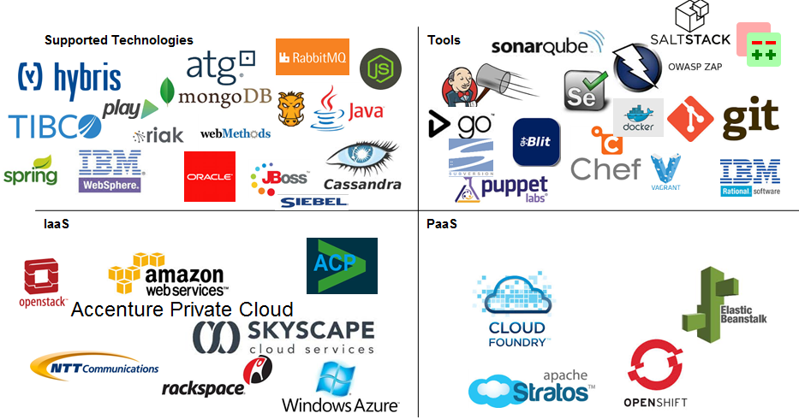
DevOps Tools

Slide 24

QUESTIONS?

